Slide 1
FYP Progress Report

Slide 2
AI Progress
Add AI Here Convincible IMAGES DIAGRAM PROBLEMS WHAT TO DO NEXT

Slide 3
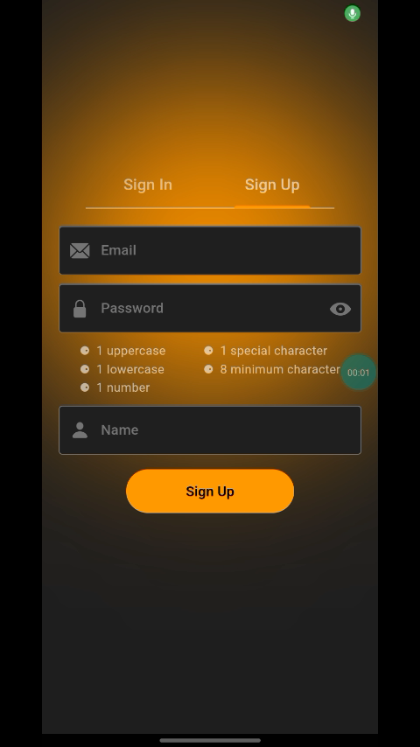
Features Completed
As shown in the video
1. Sign Up
2. Sign Out
3. Add Item
4. Show Items
Using local images for item yet . Images of medical items needs to be stored in AWS S3. We have to figure out if we should upload from the app or send to backend and upload from there. We will start working more on UI more as Backend is mostly complete

Slide 4
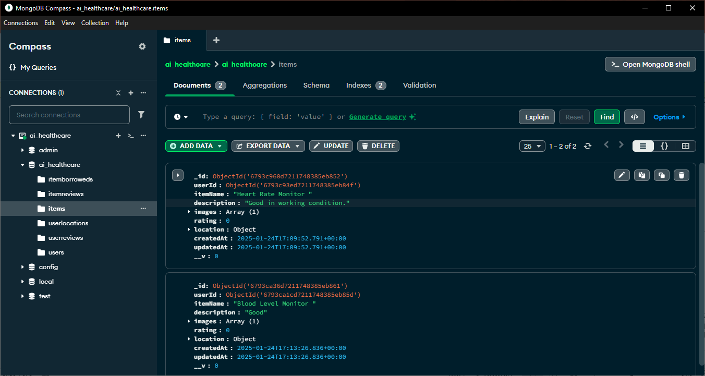
Backend Progress

Slide 5
